Slide 1
Data Analysis of HEART UCI DATASET
BY GROUP 3:
Navya P Hegde PES2201800017
Disha Venkatesh PES2201800109
Ks Koulini PES2201800399

Slide 2
About our dataset
Our dataset, which can be found on kaggle.com and its source traced back to the UCI machine learning repository is named Heart Disease UCI and is one which tabulates the various health factors of patients and finally states weather or not they were diagnosed with a heart disease. The goal of our analysis is to be able to determine which factor among these is most closely correlated to the chances of having a heart disease.

Slide 3
Understanding our variables
Our dataset consists of 14 variables:
age in years
Sex (1 = male; 0 = female)
Cp chest pain type
Trestbps resting blood pressure (in mm hg on admission to the hospital)
Chol serum cholestoral in mg/dl
Fbs (fasting blood sugar > 120 mg/dl) (1 = true; 0 = false)
Restecg resting electrocardiographic results
Thalach maximum heart rate achieved
Exang exercise induced angina (1 = yes; 0 = no)
oldpeakST depression induced by exercise relative to rest
slopethe slope of the peak exercise st segment
Ca number of major vessels (0-3) colored by flourosopy
Thal 3 = normal; 6 = fixed defect; 7 = reversable defect
Target 1 or 0

Slide 4
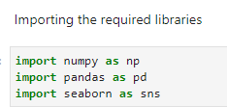
Libraries used for displaying and visualization
The libraries imported for the analysis of our data are namely
Numpy
NumPy is a library for the Python programming language, adding support for large, multi-dimensional arrays and matrices, along with a large collection of high-level mathematical functions to operate on these arrays.
Pandas
pandas is a software library written for the Python programming language for data manipulation and analysis. In particular, it offers data structures and operations for manipulating numerical tables and time series.
Seaborn
Seaborn is a Python data visualization library based on matplotlib. It provides a high-level interface for drawing attractive and informative statistical graphics.

Slide 5
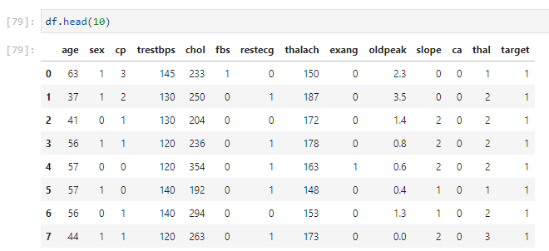
Reading and displaying our data
We load our dataset using the command pd.read_csv(). This is done as our dataset is in the form of a test file with comma separated values. ‘df’ is now a variable that holds our dataset and is called a DataFrame.
We use the command df.head() to read the top few rows of the tables. By default the command returns the top 5 rows of the table and upon passing 10, will return the top 10 rows of the table

Slide 6
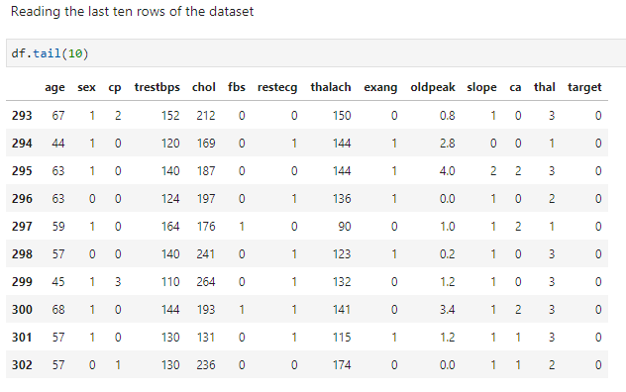
Using a similar command called df.head() we can choose to read the last 10 lines of our dataset

Slide 7
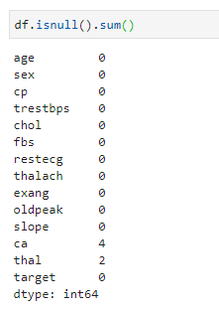
Pre-processing our data: checking for null values
We found that two of our numerical columns had a few missing values

Slide 8
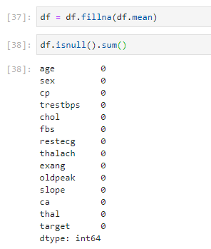
We replaced these missing values by the mean of the columns.

Slide 9
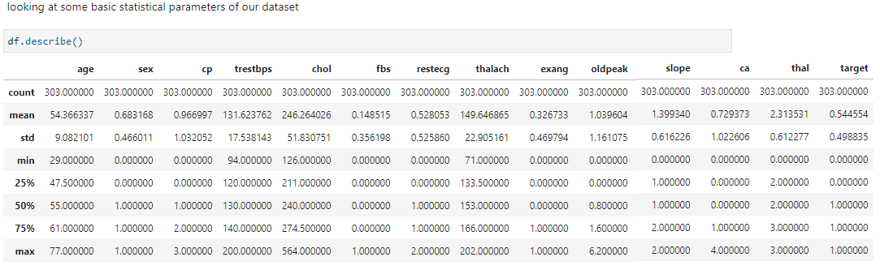
Calling .describe function on our dataset returns basic statistical parameters over each of our columns such as the total number of entries, the mean, the standard deviation, the minimum and maximum value and the fire three quartiles
It is now easy to see that the oldest person to be diagnosed was 77 years old while the youngest person to be diagnosed was 29 years old. The highest level of cholesterol measured was found to be 564 and the lowest was found to be 94 with the values surround a mean of 246.2640

Slide 10
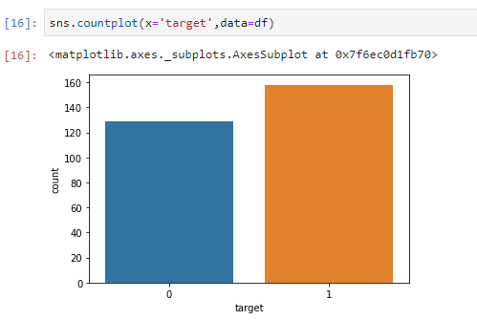
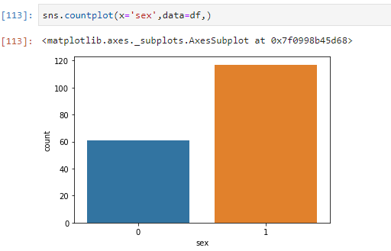
Initial visualization
The countplot gives an idea of how many of the patients were diagnosed with a heart disease
The countplot show how many of the patients where men (1) and how many were women (0)

Slide 11
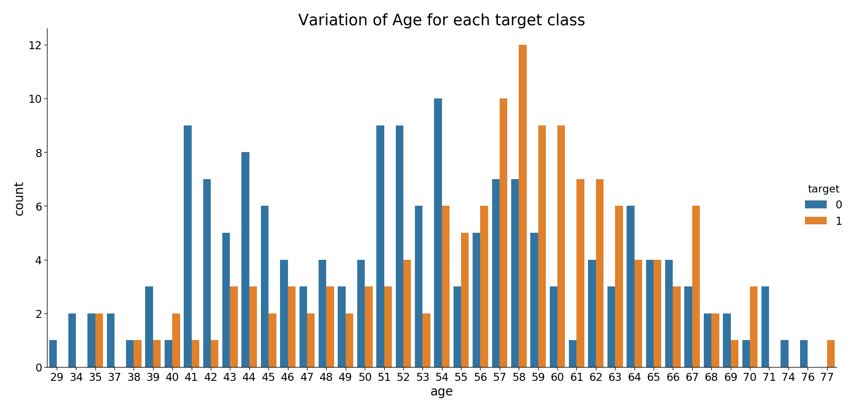

Slide 12
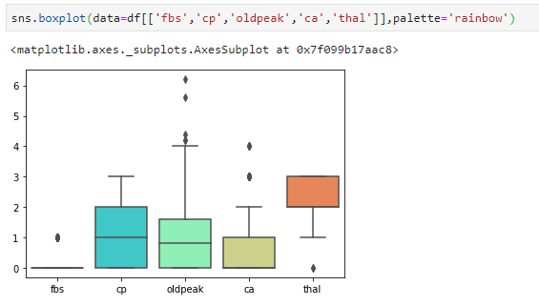
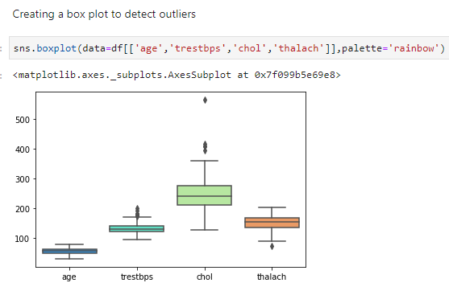
Searching for outliers can easily be detected by plotting a box pot

Slide 13
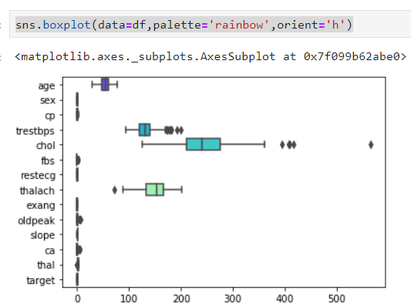

Slide 14
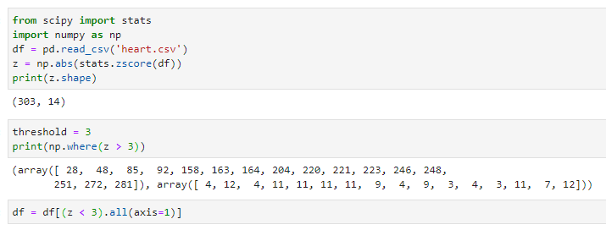
Removing outliers
Z-score method The Z-score, or standard score, is a way of describing a data point in terms of its relationship to the mean and standard deviation of a group of points. Taking a Z-score is simply mapping the data onto a distribution whose mean is defined as 0 and whose standard deviation is defined as 1. The goal of taking Z-scores is to remove the effects of the location and scale of the data, allowing different datasets to be compared directly. The intuition behind the Z-score method of outlier detection is that, once we’ve centred and rescaled the data, anything that is too far from zero (the threshold is usually a Z-score of 3 or -3) should be considered an outlier.

Slide 15
Correlating our data
Correlation is a statistical measure that indicates the extent to which two or more variables fluctuate together. A positive correlation indicates the extent to which those variables increase or decrease in parallel; a negative correlation indicates the extent to which one variable increases as the other decreases. The correlation coefficient is independent of change of origin and scale. As such standardization or normalization will not alter the value of correlation.

Slide 16
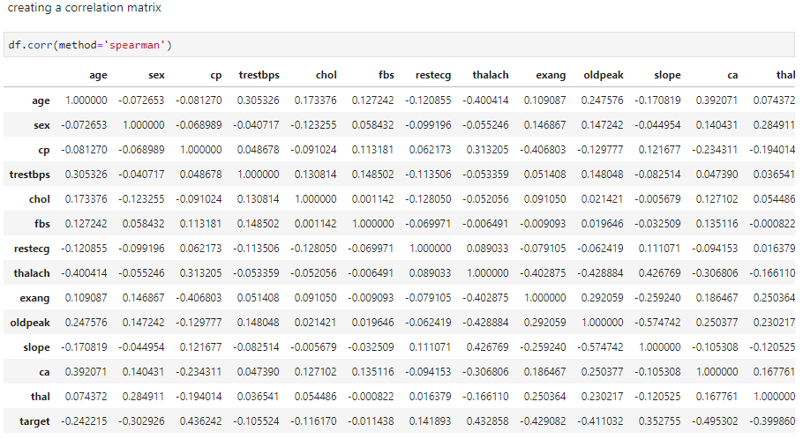
From the correlation matrix it is easy to spot which variables are strongly and weakly correlated. If two or more variables were very strongly correlated we may choose to drop one of those variables to decrease the dimensionality of our table. Since target is the variable we are trying to predict we may observe which variables are closely tied with the same

Slide 17
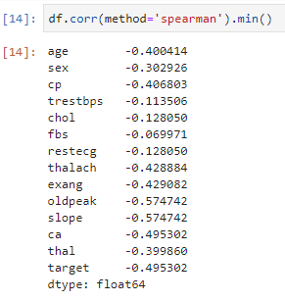
Some of the strongest negatively correlated variables

Slide 18
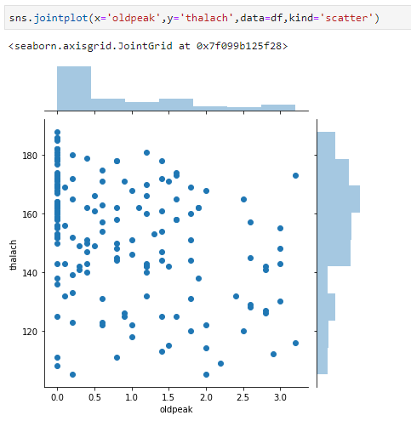
Visualizing our data
We use seaborns joint plot to observer the relation between variables. ‘oldpeak’ and ‘Thalach’ were found to have a correlation factor of -0.4004

Slide 19
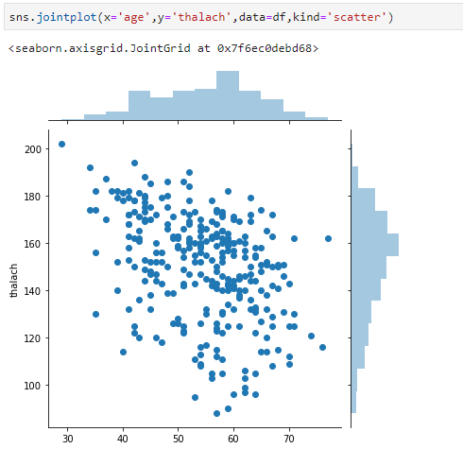
.‘age’ and ‘Thalach’ were found to have a correlation factor of -0.4288

Slide 20
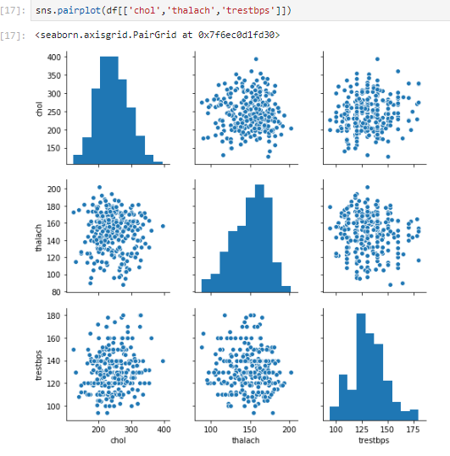
Comparing how correlates some numerical columns are

Slide 21
Standardizing and normalizing our dataset
“Normalizing” a vector most often means dividing by a norm of the vector. It also often refers to rescaling by the minimum and range of the vector, to make all the elements lie between 0 and 1 thus bringing all the values of numeric columns in the dataset to a common scale. “Standardizing” a vector most often means subtracting a measure of location and dividing by a measure of scale. For example, if the vector contains random values with a Gaussian distribution, you might subtract the mean and divide by the standard deviation, thereby obtaining a “standard normal” random variable with mean 0 and standard deviation 1.
Variables that are measured at different scales do not contribute equally to the analysis and might end up creating a bias. To bring all the measured values to the same scale we must standardize. Similarly, the goal of normalization is to change the values of numeric columns in the dataset to a common scale, without distorting differences in the ranges of values.

Slide 22
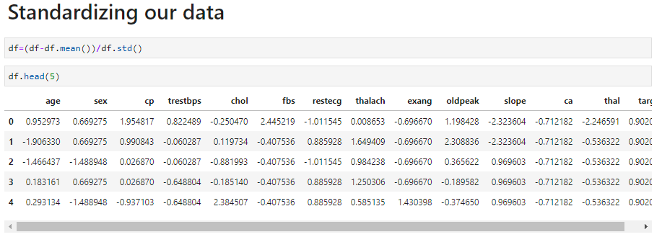
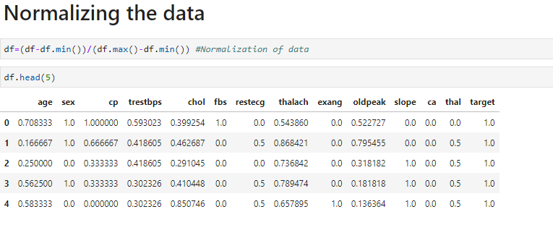

Slide 23
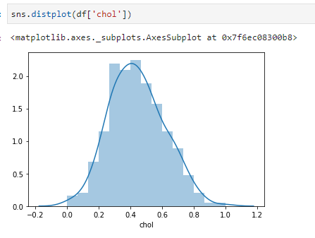
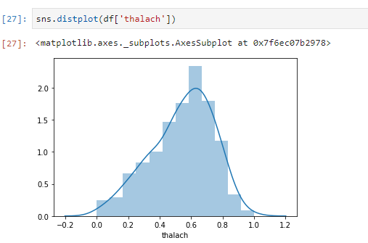
Visualizing our normalized data

Slide 24
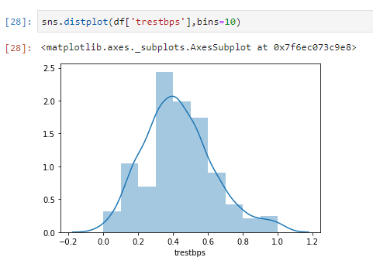

Slide 25
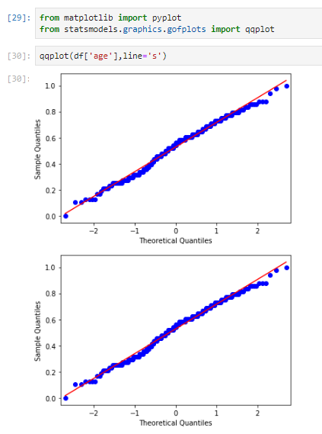
Q-Q plots
A Q-Q plot is a scatterplot created by plotting two sets of quantiles against one another. If both sets of quantiles came from the same distribution, we should see the points forming a line that's roughly straight.

Slide 26
Hypothesis testing
Hypothesis testing is used to infer the result of a hypothesis performed on sample data from a larger population. The test tells the analyst whether or not his primary hypothesis is true. Statistical analysts test a hypothesis by measuring and examining a random sample of the population being analysed.

Slide 27

Models imported for Hypothesis testing
Scikit-learn (formerly scikits.learn and also known as sklearn) is a free software machine learning library for the Python programming language.[3] It features various classification, regression and clustering algorithms including support vector machines, random forests, gradient boosting, k-means and DBSCAN, and is designed to interoperate with the Python numerical and scientific libraries NumPy and SciPy.
Statsmodels is a Python package that allows users to explore data, estimate statistical models, and perform statistical tests. An extensive list of descriptive statistics, statistical tests, plotting functions, and result statistics are available for different types of data and each estimator. It complements SciPy's stats module.

Slide 28
Our hypothesis
We are assuming that a person with a cholesterol level lesser than 0.4421 has a higher chance of getting a heart disease.
So this is our NULL hypothesis.
H0:μ<= μ₀
Alternate hypothesis
H1:μ> μ₀
Where our value of μ₀ is 0.4421
Value of μ is 0.200

Slide 29
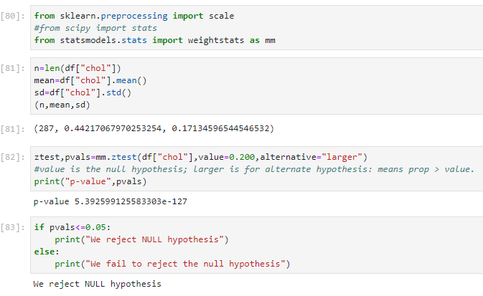

Slide 30
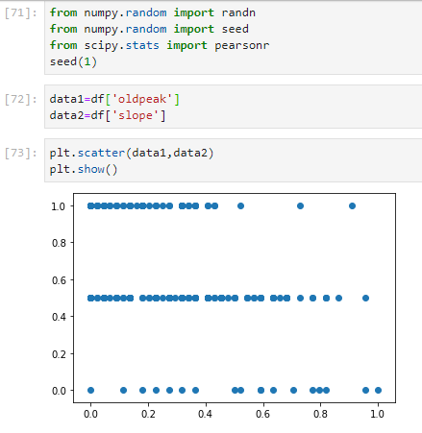
Some final visualization

Slide 31
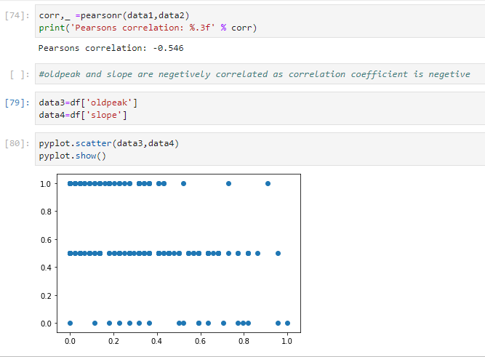
Correlative plot

